Slide 1
INTERACTION DIAGRAMS

Slide 2
INTERACTION VIEW
The interaction view describes sequences of
message exchanges among roles that implement
behavior of a system.
This view provides a more holistic view of the
behavior of a set of objects, modeled by
collaborations.
A collaboration is a description of a collection of
objects that interact to implement some behavior
within a context.

Slide 3
An interaction is a set of messages within a
collaboration that are exchanged by classifier
roles across association roles.
A classifier role represents a description of
the objects that can participate in an
execution of the collaboration.
An association role represents a description
of the links that can participate in an
execution of the collaboration.

Slide 4
Interaction Diagrams:
Interaction diagrams are models that describes how groups of objects collaborate to realize some behavior.
Typically, each Interaction diagram realizes the behavior of a single use case.
An Interaction diagram shows a number of example objects and the messages that are passed between the objects within the use case.

Slide 5
Interaction Diagrams:
The interaction view is displayed in two diagrams focused on different aspects
  Sequence Diagram
  (focusing on the time sequences of the messages)
  Collaboration Diagram
  (focusing on the relationships among the objects that exchange the messages).

Slide 6
Interaction Diagram:
These two diagrams are equal in sense that any one diagram can be derived automatically from other.
However they are both useful.
These two actually portray the different perspectives of behavior of the system and different types of inferences can be drawn from them.

Slide 7
Sequence Diagram:
A sequence diagram shows interaction among the objects as a two-dimensional chart.
The vertical dimension is the time axis; time proceeds down the page.
The horizontal dimension shows the classifier roles that represent individual objects in the collaboration.
The chart is read from top to bottom.

Slide 8
Sequence Diagram:
The objects participating in the interaction are shown at the top of the chart as boxes attached to a vertical dashed line.
Inside the box the name of the objects are written with a colon separating it from the name of the class, and both the name of the object and the class are underlined.

Slide 9
Sequence Diagram:
The objects appearing at the top signify that the objects already existed when the use case execution was initiated.
If some object is created during the execution of the use case and participates in the ( e.g. method call), then that object should be shown at the appropriate place on the diagram where it was created.

Slide 10
Sequence Diagram:
The vertical dashed line is called the object’s lifeline.
The lifeline indicate the existence of the object at any particular point of time.
The rectangle drawn on the lifeline is called activation symbol and indicates that the object is active as long as the rectangle exists.

Slide 11
Sequence Diagram:
Each message is indicated as an arrow between the lifelines of two objects.
The messages are shown in chronological order from top to the bottom.
That is, reading the diagram from top to the bottom would show the sequence in which the messages occur.
Each message is labeled with the message name.

Slide 12
Sequence Diagram:
Some control information can also be included.
Two types of control information are particularly valuable.
  a condition (e.g. [invalid] ) indicates that a message is sent, only if the condition is true.
  An interaction marker (*) shows that the message is sent many times to multiple receiver objects as would happen when you are iterating over a collection or the elements of an array

Slide 13
Sequence Diagram:
  Objects
    Each object is shown as rectangle, which is labelled object Name: class Name
  Links
    Links between objects are shown like associations in the class model.
  Actors
    Actors can be shown as on a use case diagram

Slide 14
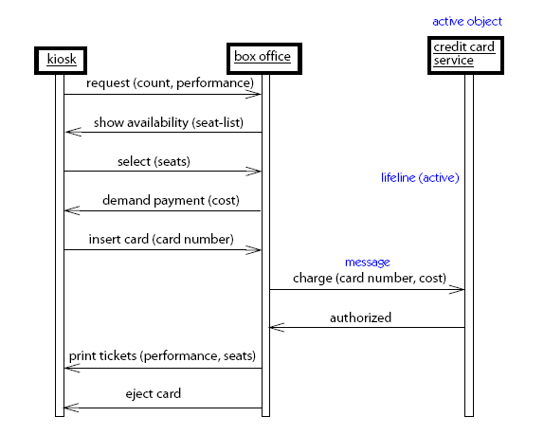

Example:

Slide 15
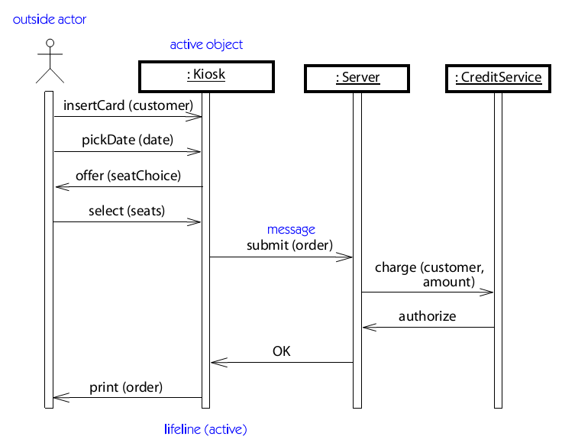
Example:

Slide 16
The vertical dimension of a sequence diagram represents time
The horizontal dimension represents the different objects or roles that participate in the interactive sequence.
An object’s lifeline is shown as a narrow vertical bar.
Time is assumed to pass as we move from top to bottom of the diagram.
Messages between objects are shown as solid line arrows, and their returns are shown as dashed line arrows.

Slide 17
resource
manager
Res. Mgr. Win: UI
:Worker
:Skill
:Skill Level
find worker
find worker
by name
find skill
find skill by name
assign skill
to worker
[worker does not currently have skill]
assign skill to worker

Slide 18
Messages from an object to itself
An object may, and frequently does, send a message to itself
On a collaboration diagram you show a link from the object to itself, and messages pass along that link in the usual way
On a sequence diagram, you show a message arrow from the object’s lifeline back to itself.

Slide 19
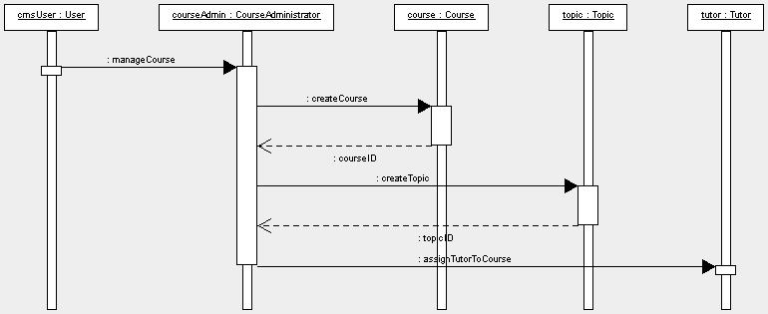
Sequence diagram For Manage course information

Slide 20
Creation and deletion of objects
Sequence diagram
  These show an object being created by putting its object box part-way down the page, at the point it is created
  Destruction of an object is shown by its activation ending with a large X.

Slide 21
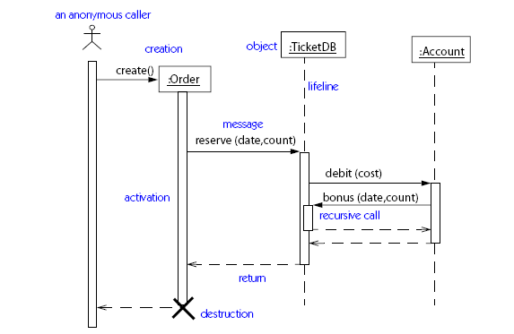
Sequence Diagram

Slide 22
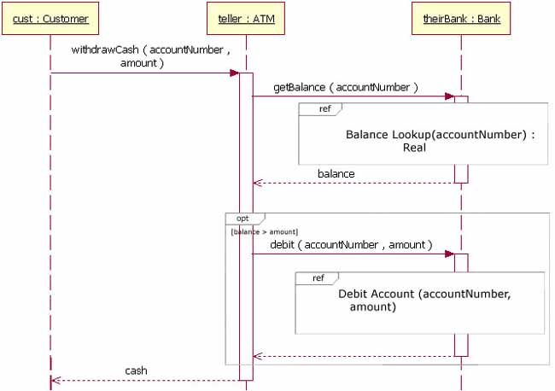
Sequence Diagram Of ATM

Slide 23
Collaboration Diagram:
A collaboration diagram is a class diagram that contains classifier roles and association roles rather than just classifiers and associations.
A collaboration diagram shows both the behavior and structural aspects explicitly.
This is unlike a sequence diagram which shows only the behavioral aspects.
The structural aspect of a collaboration diagram consists of objects and the links existing between them.

Slide 24
Collaboration Diagram:
In this diagram , an object is also called a collaborator.
The behavior aspect is described by the set of messages exchanged among the different collaborators.
The links between the objects is shown as a solid line and can be used to send messages between two objects.
  Collaboration diagrams contain objects, links, and messages.

Slide 25
Collaboration Diagram:
Message :
Messages are shown as labeled arrows attached to links.
Each message has a sequence number, an optional list of predecessor messages, an optional guard condition, a name and argument list, and an optional return value name.
The sequence number includes the (optional) name of a thread.
All messages in the same thread are sequentially ordered.

Slide 26
Collaboration Diagrams
  A use of the collaboration diagram is our development process would be to help us determine which classes are associated with which other classes.
  This type of diagram emphasizes the relationship between objects whereas sequence diagrams emphasize the sequence of events.

Slide 27
Creation and deletion of objects
The set of objects involved in an interaction is not always static; objects may be created and deleted during an interaction.
  These show which objects are created and destroyed during an interaction by adding the constraints {new} {destroyed}.
  If the object is both created and destroyed in the same interaction, it can be labelled {transit}

Slide 28
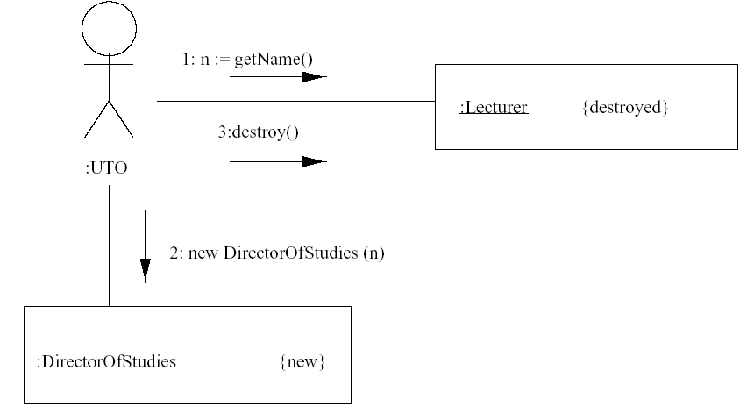
Collaboration diagram

Slide 29
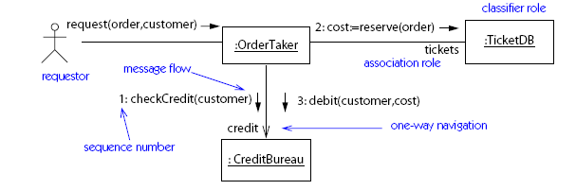
Collaboration diagram

Slide 30
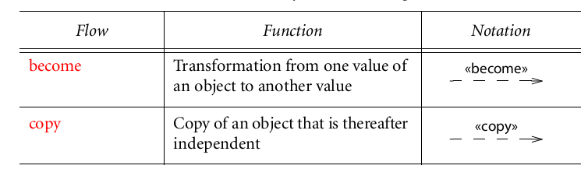
Collaboration diagram
FLOWS:
There are two kinds of flow relationship between objects.

Slide 31
BECOME FLOW:
The various object symbols that represent one object may be
connected using become flows. A become flow is a transition
from one object state to another.
It may be labeled with a sequence number to show when it
occurs. A become flow is also used to show migration of an
object from one location to another.
COPY FLOW:
Less commonly, the stereotype «copy» shows an object value
produced by copying another object value.

Slide 32
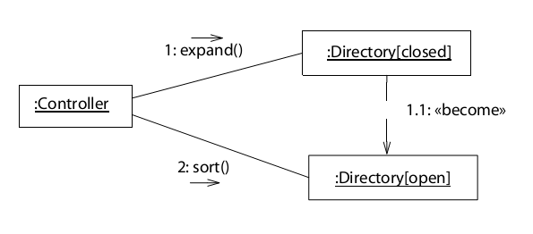
Collaboration diagram

Slide 33
Difference between Sequence and Collaboration Diagram:
Collaboration diagrams and sequence diagrams both show interactions, but they emphasize different aspects.
Sequence diagrams show time sequences clearly but do not show object relationships explicitly.
Collaboration diagrams show object relationships clearly, but time sequences must be obtained from sequence numbers.
In sequence diagrams, objects are shown with no connection.

Slide 34
Difference between Sequence and Collaboration Diagram:
In collaboration diagrams, those objects that collaborate to perform the role based on the message received are connected.
Both are alternative to each other.
The sequence diagram, easier to understand but does not show the flow of the behavior and collaboration of objects.
The collaboration diagram shows both collaboration and sequence.

Slide 35
Difference between Sequence and Collaboration Diagram:
Sequence diagrams are often most useful for showing scenarios.
collaboration diagrams are often more useful for showing detailed design of procedures.

